Slide 1
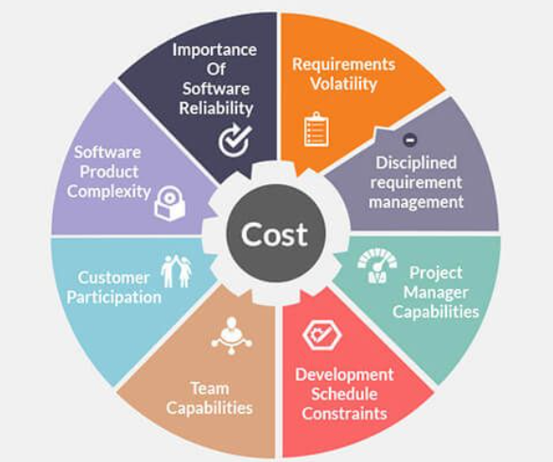
Effort Estimation in Project Management(Planning S/W Project)

Slide 2
Effort Estimation
Effort estimation is the process of forecasting how much effort is required to develop or maintain a software application.
This effort is traditionally measured in the hours worked by a person, or the money needed to pay for this work.
It involves predicting the amount of time and effort required to complete a particular task or project.
Effort estimation is used to help draft project plans and budgets in the early stages of the software development life cycle.
This practice enables a project manager or product owner to accurately predict costs and allocate resources accordingly.

Slide 3
Effort estimation in Agile
more commonly associated with the Agile methodology.
Here, the product owner must manage a list of project deliverables, known as a backlog.
They will estimate the effort required to complete each item. Rather than using time or cost estimates, they will look at user stories and story points.
A user story is a tool used to describe a software feature from the perspective of the consumer
A story point is a unit that measures the amount of work in implementing a user story, taking into account the level of difficulty involved and the potential risk
A product owner will compare the features of their new project with a previous one to determine the complexity of their user story and assign suitable story points

Slide 4
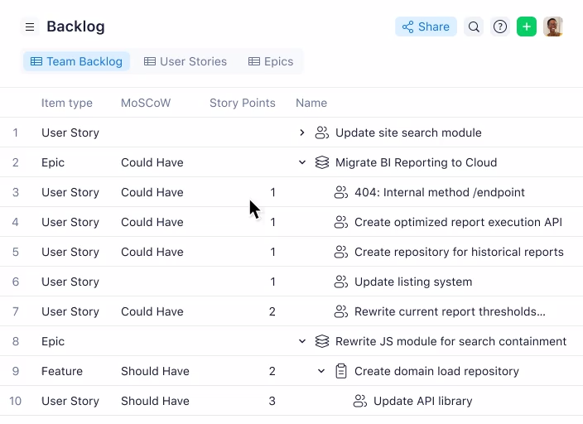
Effort estimation

Slide 5
Agile effort estimation techniques
Planning Poker: In this method, team members sit together in a circle to assign values to story points.
Each individual will have a set of cards with the numerical values that can be assigned: 0, 1, 2, 3, 5, 8, 13, 20, 40, and 100.
The product owner will read out a user story to the team members. They will have a discussion and then decide which value it should have.
If everyone is in agreement, the final estimate is decided. If not, the team will discuss further until a consensus is reached.

Slide 6
Agile effort estimation techniques
2. T-shirt Sizes: Here, story points take the form of sizes: extra-small (XS), small (S), medium (M), large (L), and extra-large (XL). Estimators will determine the sizes to get a quick and rough estimate that can be converted to numbers later.
3. Dot voting: This approach enables team members to sort items in the product backlog from low to high priority. User stories are posted on a board and estimators get four or five dots to use as votes. The one with the most dots is deemed the highest-priority item, and so on.

Slide 7
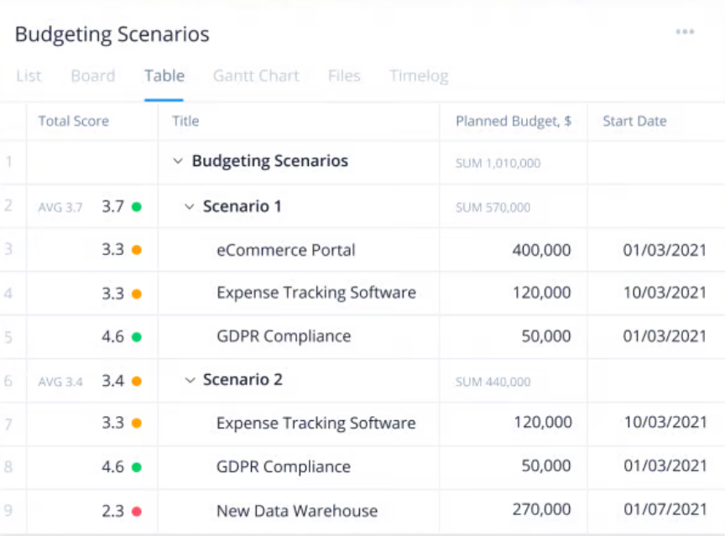
types of estimations take place during a project?
Cost: It is one of the three main constraints in project management. If you don’t have enough money to complete the project, it will fail.
Cost estimation involves predicting how much money you will need for the project as well as when you will need the funds.

Slide 8
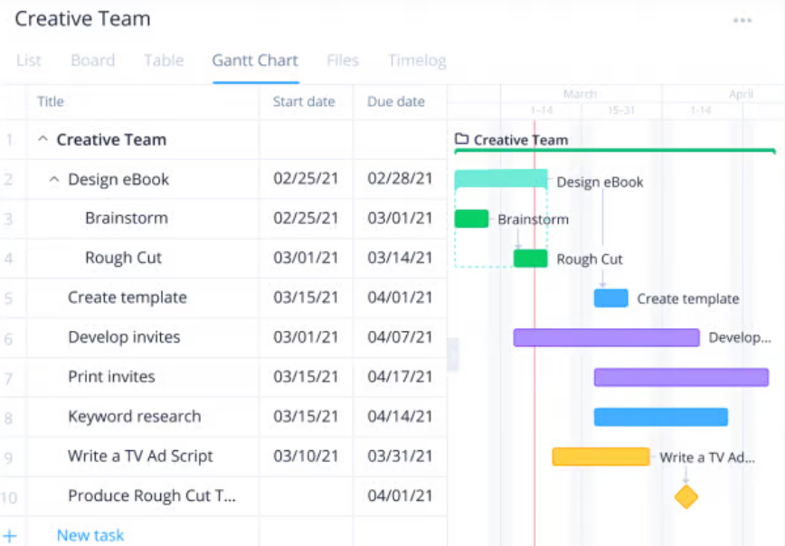
types of estimations take place during a project?
Time : another of the three main project constraints. Being able to estimate both the overall project duration and when individual tasks will take place is vital to project planning.
Estimating your project schedule enables you to arrange for people and resources to be available when you need them. It also allows you to manage client expectations around when they should receive key deliverables.

Slide 9
types of estimations take place during a project?
Scope: Scope is the third key project constraint. Project scope is all the work that must be done to finish the project or deliver a product. By estimating how much work is involved and exactly what tasks need to occur, you can ensure that you have the right materials and expertise for the project.
The three main constraints are often referred to as three sides of a triangle. This is because whatever changes are made to one constraint will inevitably impact the other two

Slide 10
types of estimations take place during a project?
Risk: Project risk is an unexpected event that could impact your project, for better or for worse. Estimating risk involves predicting what events may occur during the project’s life cycle and how seriously they could impact the project.
By estimating what risks could impact your project and how they will affect it, you are better able to plan for potential issues and create risk management plans.

Slide 11
types of estimations take place during a project?
Resources: Project resources are the assets you need to get the project done. Resources can be tools, people, materials, subcontractors, software, and more. Resource management helps you ensure you have all the resources you need and use them as efficiently as possible.
Without estimating what resources you will need, and when, it’s challenging to plan how you will manage them. This can lead to people sitting around idle or materials not showing up until weeks after you need them.

Slide 12
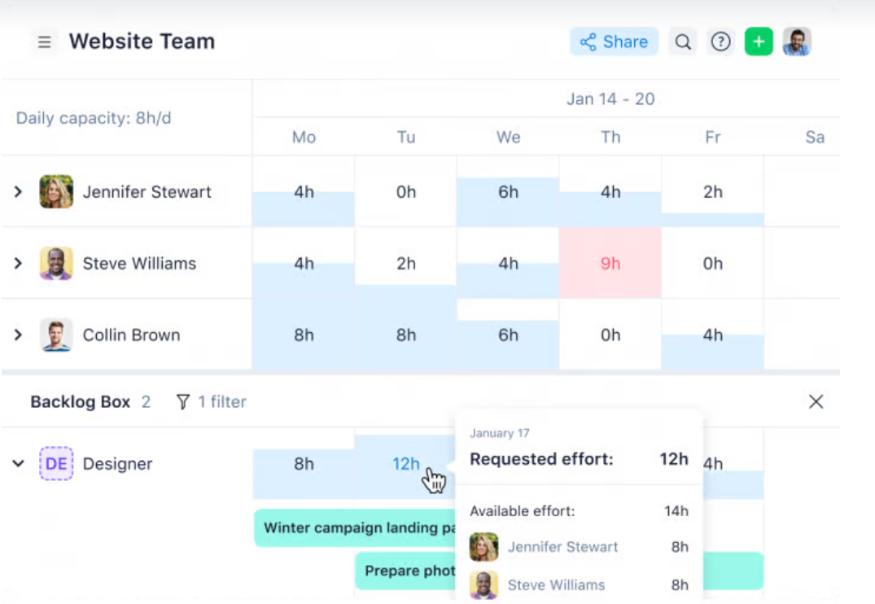
Resources in PM(effort esti)

Slide 13
types of estimations take place during a project?
Quality: Quality focuses on how well the project deliverables are completed. Products that have to meet demanding quality regulations, such as environmental restrictions, may require more money, time, and other resources than a product with lower-level requirements.
Estimating the level of quality that the customer requires helps you plan and estimate the other five aspects of your project.

Slide 14
Techniques of project scheduling
It is essential for ensuring the successful completion of projects within the set timelines and allocated resources.
It provides a roadmap for the project, outlining the sequence of tasks to be performed, their dependencies, and the time allocated for each task.

Slide 15
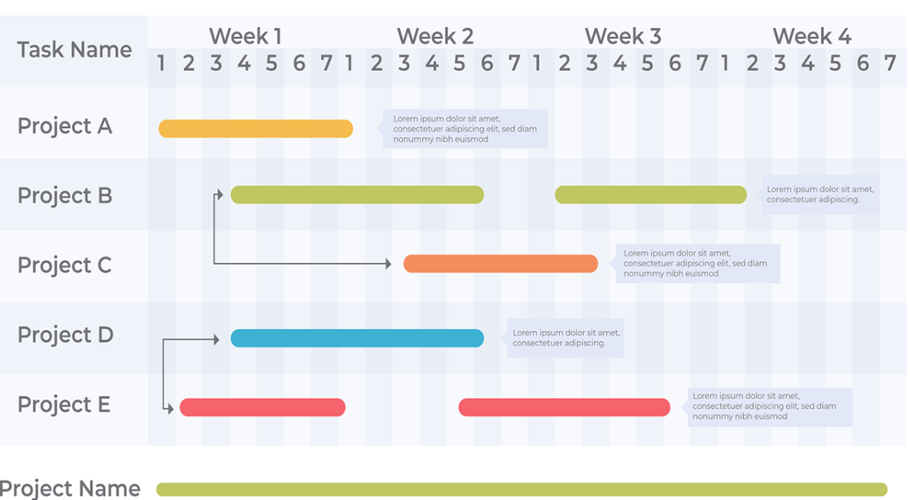
Techniques of project scheduling
1. Gantt charts

Slide 16
Techniques of project scheduling
Gantt charts are a popular technique for project scheduling in software engineering.
They provide a visual representation of the project schedule, depicting the start and end dates of the various tasks and their interdependencies.
This visualisation aids in understanding the project’s flow and identifying potential bottlenecks.
Additionally, Gantt charts facilitate progress tracking and enable team members to stay on the same page when shared.
By comparing the planned schedule with the actual progress, project managers can identify deviations and take corrective actions promptly.

Slide 17
Techniques of project scheduling
2. Critical Path Method (CPM)
The Critical Path Method (CPM) is another widely used project scheduling technique in software engineering.
It involves identifying the longest sequence of tasks in a project, known as the critical path. This path determines the shortest possible duration for the project.
CPM aids in prioritising tasks. Tasks on the critical path have zero slack time, meaning any delay in these tasks will delay the entire project.

Slide 18
SDLC
SDLC specifies the tasks to be performed at various stages by a software engineer or developer. It ensures that the end product is able to meet the customer's expectations and fits within the overall budget.
SDLC comprises a detailed description or step-by-step plan for designing, developing, testing, and maintaining the software.
A frequent issue in software development is the delay of security-related tasks until the testing phase, which occurs late in the software development life cycle (SDLC) and occurs after the majority of crucial design and implementation has been finished. During the testing phase, security checks may be minimal and restricted to scanning and penetration testing, which may fail to identify more complicated security flaws.
Security issue can be address in SDLC by following DevOps

Slide 19
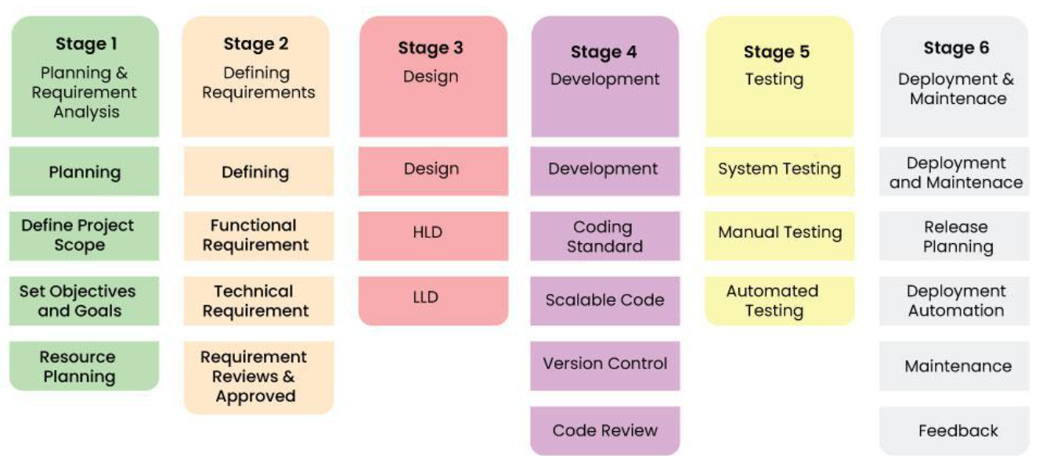
6 stages of SDLC(software Development Life Cycle)

